Slide 1
Task 3 – “Sales Dashboard”
Name – ANKUR VERMA
Date – 19-June-2026

Slide 2
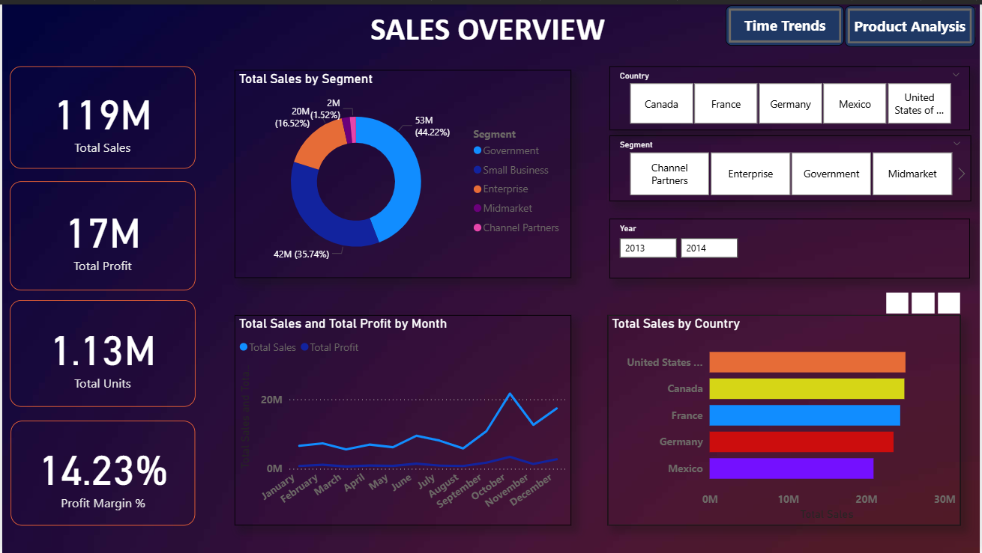

Slide 3
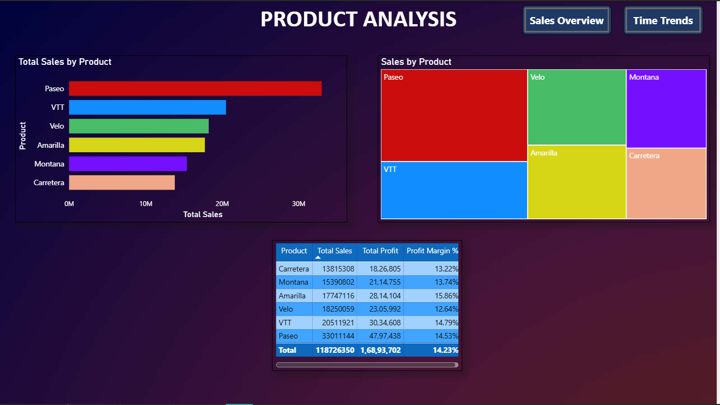

Slide 4
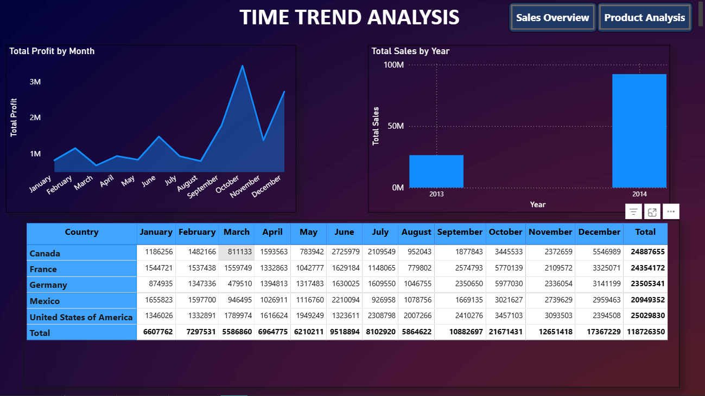

Slide 5

Key Insights
1. Overall Performance
The business generated total revenue of $118.73M with a net profit of $16.89M
Overall Profit Margin stands at 14.23%
2. Year-over-Year Growth
Sales in 2014 were significantly higher compared to 2013, indicating strong business growth
3. Product Performance
Paseo was the top-selling product with $33M in total sales
Amarilla achieved the highest profit margin at 15.86%
Carretera had the lowest profit margin at 13.22%
4. Country Performance
United States of America led all countries with the highest sales of $25M
Mexico recorded the lowest sales among all countries
5. Segment Analysis
Government segment dominated with 44.22% of total market share
Channel Partners was the smallest segment contributing only 1.52% of sales
6. Profit Leaders
VTT product generated the highest total profit of $30.34M
Paseo contributed the most to overall revenue growth

